Slide 1

Linked List
By: Guillermo Andres De Mendoza Corrales

Slide 2
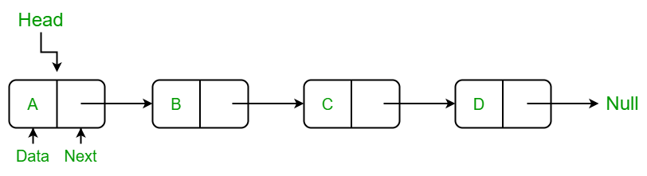
Theory
A Linked List is a linear data structure where elements are not stored in contiguous memory locations. Instead, elements are linked using pointers.
2. The Anatomy of a Node
Each element in a linked list is called a Node, which consists of two parts:
Data: The actual value stored (integer, string, etc.).
Next: A pointer or reference to the next node in the sequence.
3. Key Characteristics
Head: The entry point of the list (the first node).
Tail: The last node, which points to NULL, signifying the end of the list.
Dynamic Size: It can grow or shrink during execution by allocating or deallocating memory.
Tail

Slide 3
Structure
Controller
HEAD
TAIL
None
None

Slide 4
Operation : append (A)
Controller
HEAD
TAIL
Node
A
None
element
next
update tail reference and last node reference
be aware of the condition when the head and tail are null (empty list)

Slide 5
Operation : append (B)
Controller
HEAD
TAIL
Node
Node
A
B
None
element
next
element
next
update tail reference and last node reference
be aware of the condition when the head and tail are null (empty list)

Slide 6
Operation : append (C)
Controller
HEAD
TAIL
Node
Node
Node
A
B
C
None
element
next
element
next
element
next
update tail reference and last node reference
be aware of the condition when the head and tail are null (empty list)

Slide 7
Operation : delete (B)
Controller
HEAD
TAIL
Node
Node
Node
A
B
C
null
null
element
next
element
next
element
next
update the reference of the neighbours position nodes

Slide 8
Operation : insert (1, E)
Controller
HEAD
TAIL
Node
Node
Node
A
E
C
null
element
next
element
next
element
next
update the reference of the neighbours position nodes
be aware of the condition when the head and tail are null (empty list)

Slide 9
Operation : update (1, Z)
Controller
HEAD
TAIL
Node
Node
Node
A
Z
C
null
element
next
element
next
element
next
update the reference of the neighbours position nodes
be aware of the condition when the head and tail are null (empty list)

Slide 10
Linked list vs Array List
Aspect | Array List | Linked List
Access | For element: O(n) For index O(1) Binary Search: O(log(n)) | O(n) no index is possible
Insert/Delete | requires shifting O(n) | no shifting O(1)
Memory | Memory Wastage | memory is only consumed when a new node is actually created

Slide 11
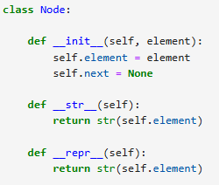
Implementation - node

